Slide 1
Capstone Project – 2 Regression “Transport Demand Prediction”
Presented By :-
Hasnain Mazhar Rizvi

Slide 2
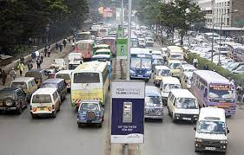
Content
Problem Statement
Data Summary
EDA
Hypothesis
Feature Manipulation
Feature selection
Data Preprocessing
ML Implementation
ML Models and Metrics
Feature Importance
Conclusion

Slide 3

Problem Statement
We're going to look at data from Mobiticket, which sells bus tickets. We'll focus on towns northwest of Nairobi towards Lake Victoria. Our goal is to figure out how many tickets will be sold for buses that arrive in Nairobi from those towns.

Slide 4
Data Summary
This dataset includes the variables from 17 October 2017 to 20 April 2018
ride_id: unique ID of a vehicle on a specific route on a specific day and time.
seat_number: seat assigned to ticket
payment_method: method used by customer to purchase ticket from Mobiticket
payment_receipt: unique id number for ticket purchased from Mobiticket
travel_date: date of ride departure. (MM/DD/YYYY)
travel_time: scheduled departure time of ride. Rides generally depart on time. (hh:mm)
travel_from: town from which ride originated
travel_to: destination of ride. All rides are to Nairobi.
car_type: vehicle type (shuttle or bus)
max_capacity: number of seats on the vehicle

Slide 5
EDA
Know Your Data
Importing Basic libraries.
Loading Dataset
After doing some basic Python work we understand our dataset and see head() and tail() And we get to know we have 51645 Rows and 10 Columns.
Duplicate Values
Null/Missing Values
Data Wrangling
Visualization of data
Note: They didn’t give us a target variable so we have to find out it first and then we can visualize the data in a proper manner.

Slide 6
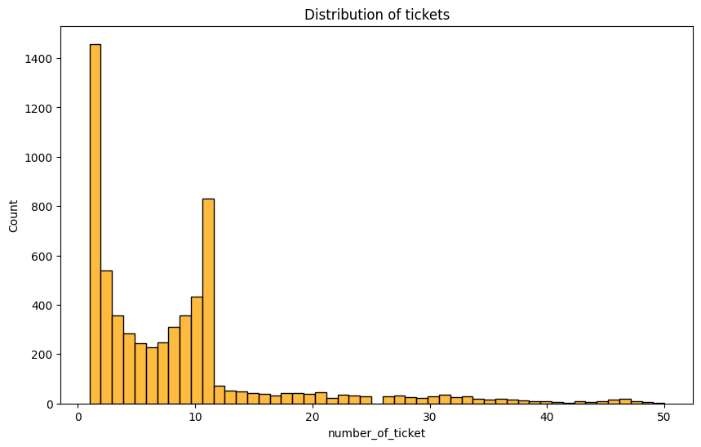
Visualization

Slide 7
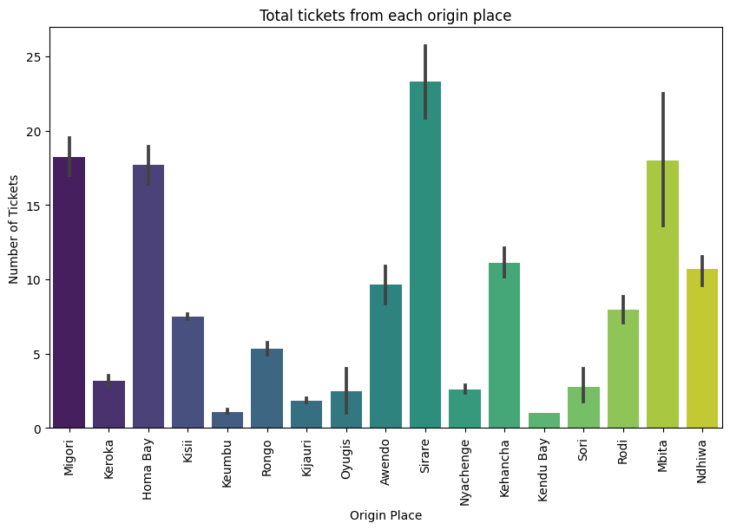

Slide 8
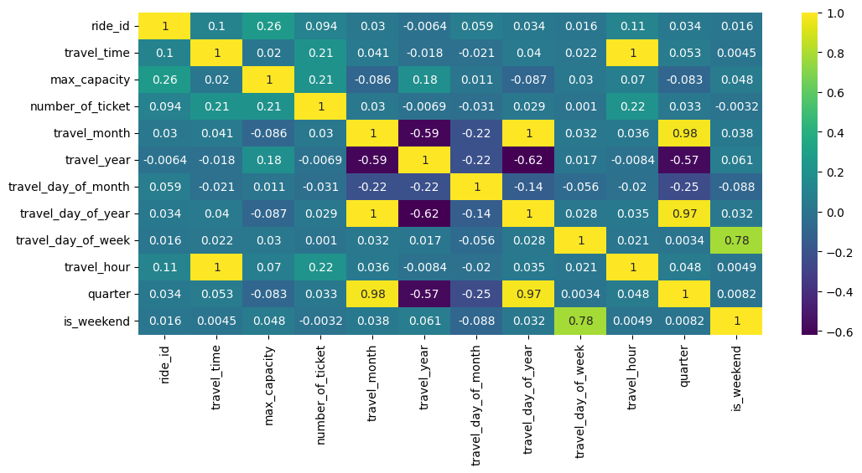
Visualization

Slide 9
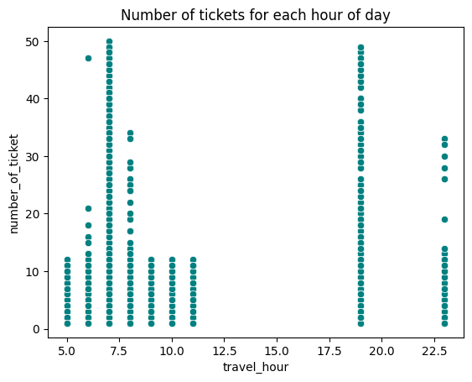
Hypothesis 1:
We Found Three Hypotheses after lots of charts so let’s discuss them one by one.
1. There are No travel activities taking place during the afternoon.

Slide 10
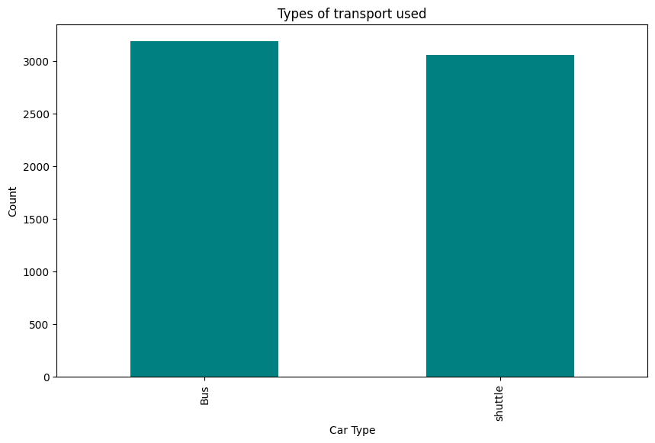
Hypothesis 2:
2. The number of buses(Nb) used in traveling is the same as the number of shuttles(Ns) used.

Slide 11
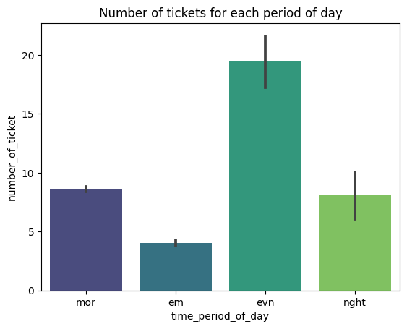
Hypothesis 3:
3. Most tickets are sold in the morning.
let’s: H0 = Most tickets are sold in the morning.
H1 = Most number of tickets are NOT sold in the morning

Slide 12
Feature Manipulation and selection
By Extracting variables from variables we found these things :
1. Some months have a higher frequency of travel.
2. Some days in the year have a very high frequency of travelers, while others have a really low frequency. This is because of more traveling being done in some months than others.
3. Some days in a month have a higher frequency of travel than others.
4. Some periods in the day have a high frequency of travel.

Slide 13
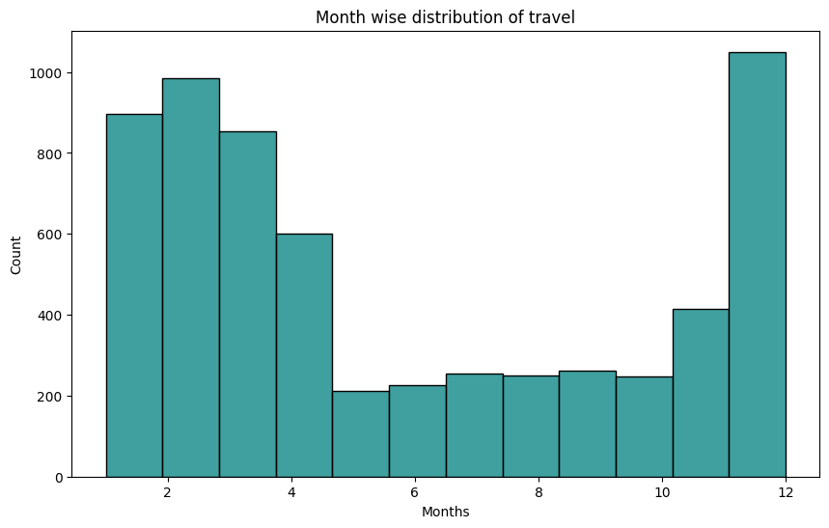
Feature Selections

Slide 14
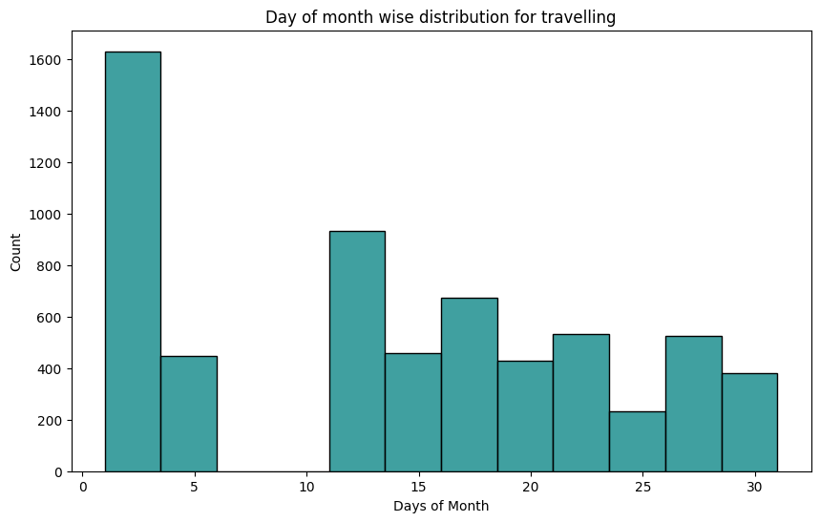
Feature Selections

Slide 15
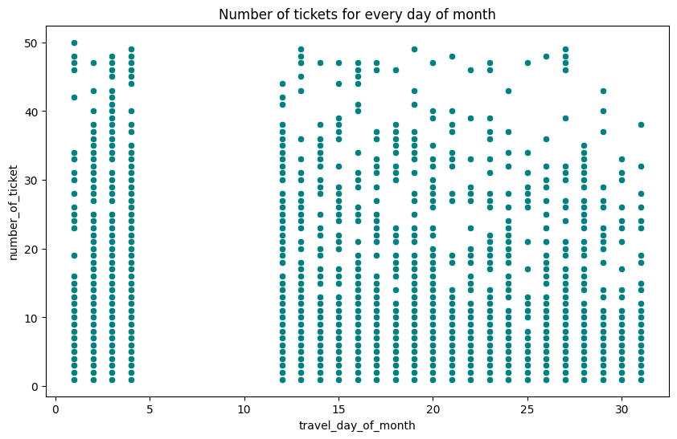
Feature Selections
Similar to the above Graph, it’s a seaborn scatter plot for another view of visualization.

Slide 16
Data Preprocessing :
To enhance the performance of the model, additional features have been generated. These new features aim to provide more relevant information and contribute to improved predictions.
Some columns travel_month, travel_day_of_year, travel_day_of_month and time_period_of_day have skewed data, to handle this, new weight wise columns have been created by taking log transformation.
Time_gap_btw_0_1_next_bus
Time_gap_btw_0_1_previous_bus
Time_gap_btw_0_2_next_bus
Time_gap_btw_0_2_previous_bus
Time_gap_btw_0_3_next_bus
Time_gap_btw_0_3_previous_bus
Time_gap_btw_next_previous_bus
.

Slide 17
ML Implementation
Five models are implemented to predict the transport demand to Nairobi. These include: Linear Models:
1. Linear Regression
2. Lasso Regression (L1)
3. Ridge Regression (L2)
Ensemble Models:
1. XGBoost
2. Random Forest

Slide 18
ML Models and Metrics
Models | R2 - Score | Adjusted R2 - Score
Linear Regression | 0.35 | 0.33
Lasso (L1) | 0.248 | 0.225
Ridge(L2) | 0.356 | 0.337
XGBoot | 0.882 | 0.887
Random Forest | 0.944 | 0.946

Slide 19
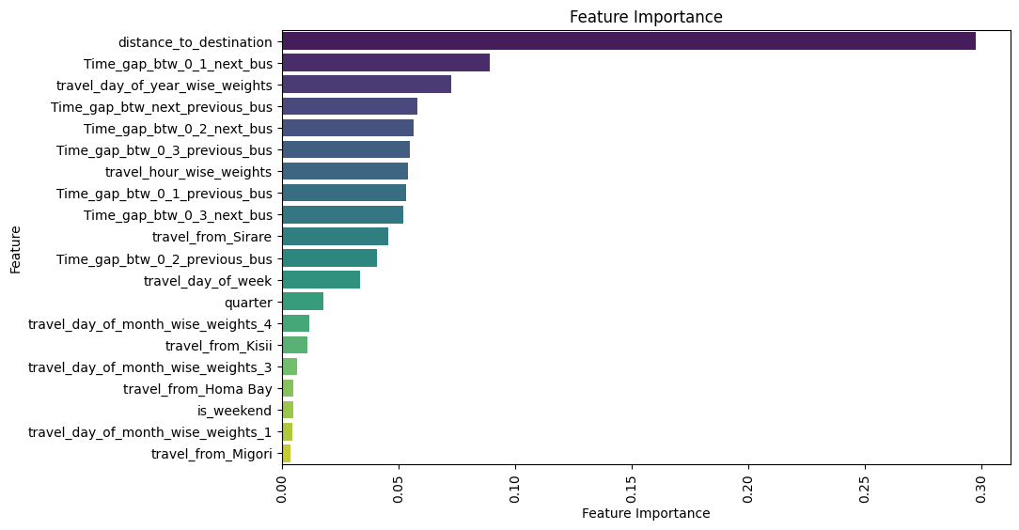
Feature Importance

Slide 20
Conclusion :
In our project, we employed diverse regression techniques to forecast transportation demand from different locations to Nairobi.
Utilizing the available data, we engineered both the target variable and several other features crucial for enhancing our model's predictive performance.
This project resulted in a hyperparameter-tuned Random Forest-based predictive model, achieving an R2 score of 94.4% for training data and 94.6% for test data.

Slide 21
Thank You AlmaBetter!

